Slide 1
EE 521/ECE 582 – Analysis of Power systems
Class #10 – September 27, 2022
UPDATED_post class
Dr. Noel N. Schulz
Edmund O. Schweitzer III Chair in
Power Apparatus and Systems
Chief Scientist Joint Appointment, PNNL
Co-Director, PNNL/WSU Advanced Grid Institute (AGI)
Washington State University Pullman
Noel.Schulz@wsu.edu EME 35
509-335-0980 (o) and 509-336-5522 (c)

Slide 2
Reminders
Student Hours This Week
Tuesdays 4:30-5:30 pm (after class) – Zoom or EME 35 Pullman
Wednesdays 4-5 pm Zoom or EME 35 Pullman
Fridays 1:30-2:30 pm Zoom or EME 35 Pullman
Remember the Discussion Set Assignment
9/30 Summary, 10/4 Questions, 10/11 Discussions
Final Paper – Think about Topic - Oct 14
Video posted on IEEE Xplore Search

Slide 3
Timeline for Class Activities
Week of Semester | Activities | Programs Suggested Deadlines
Sept 26 | Discussion Set Summary 9/30
Oct 3 | Discussion Set Questions 10/4 | Power Flow Program
Oct 10 | Discussion Set Responses 10/11 Paper Topic Due: 10/14
Oct 17 | Discussion Set #2 | Sparse Power Flow Program
Oct 24
Oct 31 | Discussion Set #3 | Continuation Power Flow Program
Nov 7
Nov 14 |  | State Estimation Program
Nov 21 | Break – No Classes
Nov 28 | Final paper presentations (T, Th) | Optimal Power Flow Program
Dec 6 | Final paper presentations (T, Th) Final paper submitted 12/9
Dec 13 | No Formal Exam | Last Day for Meeting with Dr. Schulz 12/13; Final Reports for Programs 12/15

Slide 4
Programming Projects: (80%)
Power Flow Project (20%)
Y_{bus}, Jacobian matrices – Newton Raphson
LU Factorization, Backward-Forward substitution for NR
Fast Decoupled
Q-limits, transformer taps
Sparse Power Flow Project (20%)
Continuation Power Flow Project (13%)
State Estimation Project (13%)
Optimal Power Flow Project (14%)
Finishing Each Assignment:
Demonstration with Dr. Schulz
Explaining Code
Results with Changed Input
Executive Summary and Code
One-to-Two page summary including iterations or other key metrics
Appendix with final results
Submission of code
Final Deadlines:
Dec 13 for meeting with Dr. Schulz
Dec 15 for final reports

Slide 5
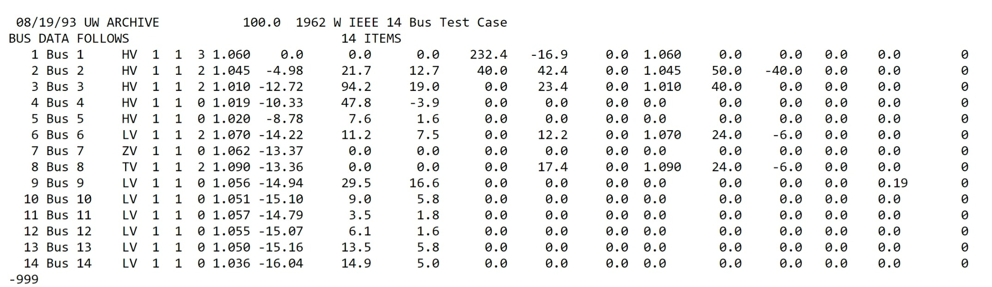
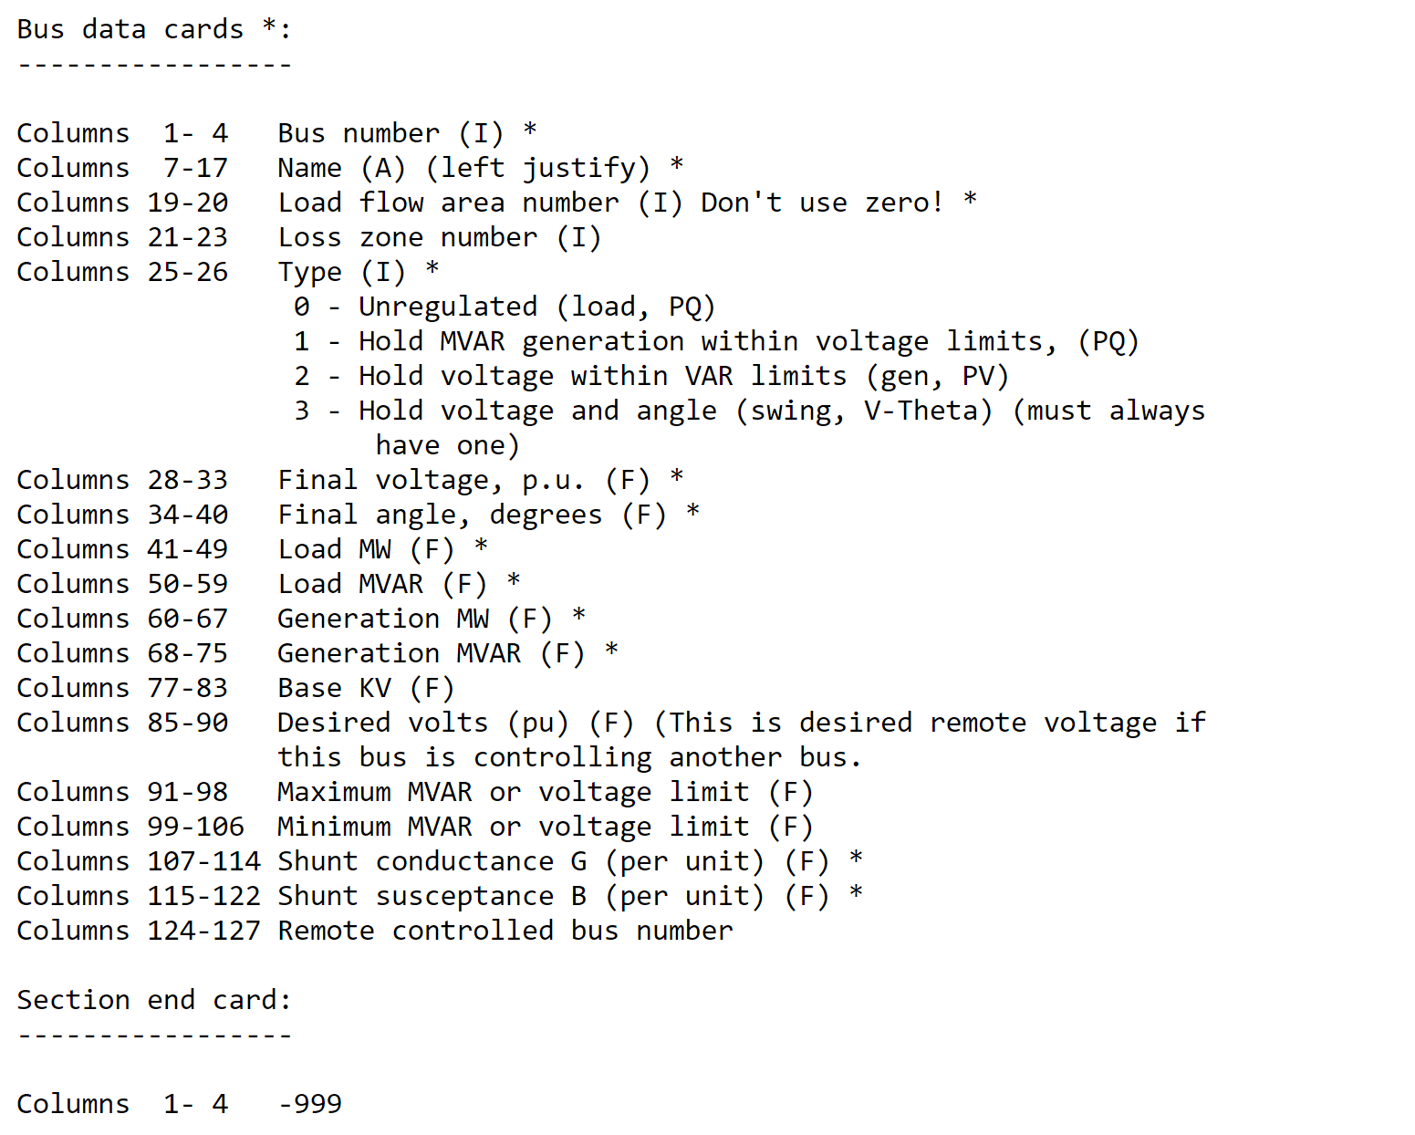
Q-Limits

Slide 6
What happens if you hit a Q limit?

Slide 7
Program #1 Power Flow
Input Data
Calculate Jacobian Terms
Without and with taps
L-U Factorization
Calculate Y_{bus}
Solve Equation [A][x] = [b]
Backward/ Forward Substitution
Calculate Jacobian Terms
Calculate Mismatch]
_{Iterative Solution}
Check Mismatch?
Small = enough
Output Results
Output Results

Slide 8
Program #1 Power Flow with Q limits
Input Data
Calculate Jacobian Terms
Calculate Y_{bus}
L-U Factorization
Calculate Jacobian Terms
Change Bus to PQ Bus & Modify Jacobian Terms Needed
Backward/ Forward Substitution
Calculate Mismatch
Not In Limits
Check Qlimits?
In Limits
_{Iterative Solution}
Check Mismatch?
Output Results
Output Results
Small enough

Slide 10
Program #1 – Power Flow of IEEE 14 bus system
Part A – Power Flow without Taps- Provide Results
Input Data
Develop Ybus without taps
Calculate Jacobian
Do LU factorization
Do backward-forward substitution
Update Values and Iterate until error norm < 0.001
Part B – Power Flow with Taps- Provide Results
Input Data
Develop Ybus with taps
Calculate Jacobian
Do LU factorization
Do backward-forward substitution
Update Values and Iterate until error norm < 0.001
Part C – Fast Decoupled Power Flow with Taps - Provide Results
Calculate Ybus with taps
Determine Fast Decoupled Values and Solve
Update values and Iterate until error norm < 0.001
Part D – Write Code to Check Q
Add step for Qmax, Qmin check
If Q > Qmax or Q< Qmin
Set Qbus=Q
Change Bus to PQ Bus
Reconstitute Jacobian

Slide 11
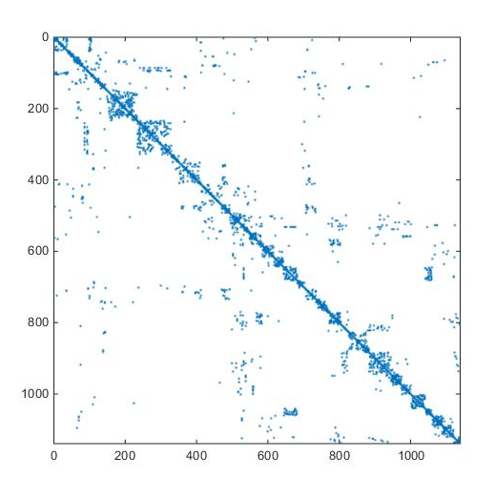
Sparse Matrices – Chapter 4
Most power system matrices are large and sparse.
A sparse matrix is one that has “very few” non-zero elements.
This matrix is 1138 x 1138 and has 4058 non-zero elements, which is a sparsity level of 0.03%.
Therefore most of the memory required to store this matrix is only storing a zero, which is not a good use of memory.
It also takes time to access these elements and perform floating point operations on zero elements.
Methods that avoid storing and calculating with zero elements are called sparse methods.

Slide 12
Storing Matrices and Doing Math With Matrices

Slide 13
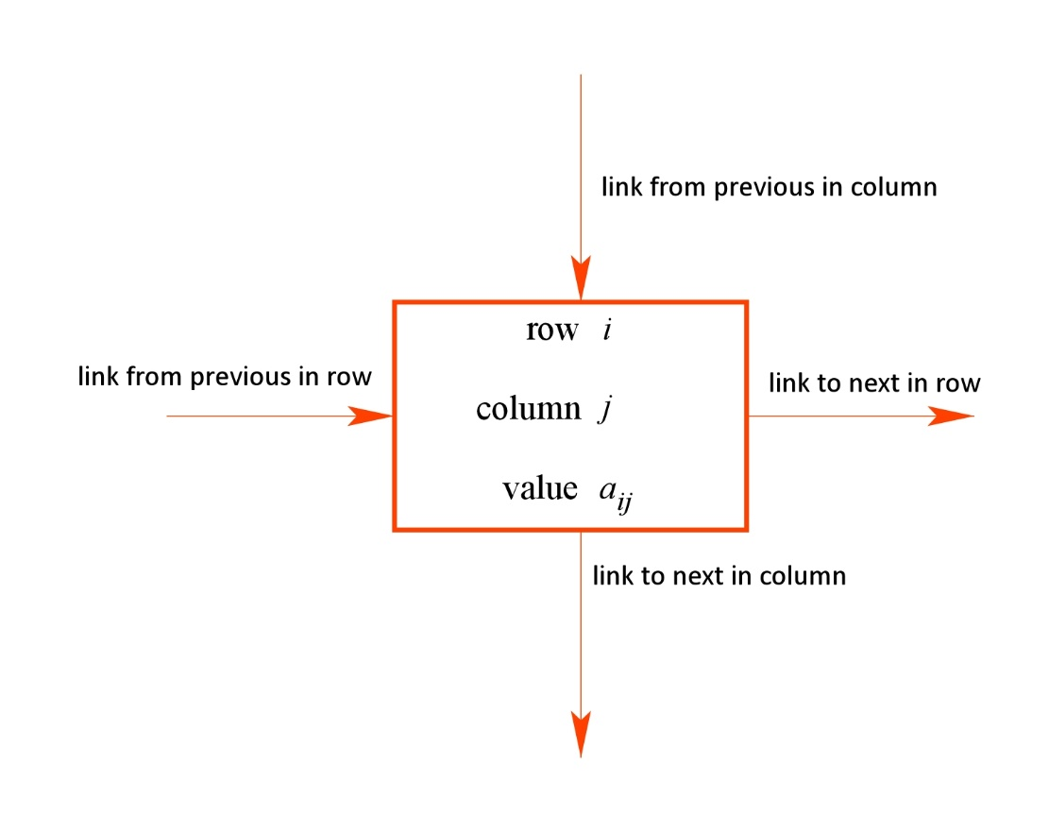
Sparse Storage
Each element in a matrix has a variety of information associated with it that distinctly identify it.
The basic information is:
Row number (integer)
Column number (integer)
Value (real)
However, to place it within the matrix in which only non-zeros are stored, a linked list approach is used.
Thus, the links connecting it within each row and column must also be specified.

Slide 14
Example: Visualize the matrix A as a linked list:
This matrix has 12 non-zero elements. The order of each element can be random.
6
Row | 3
Column | 3
Value | 3
5
Row | 2
Column | 4
Value | 1
12
Row | 5
Column | 5
Value | -4
2
Row | 1
Column | 3
Value | -2
1
Row | 1
Column | 1
Value | -1
8
Row | 4
Column | 2
Value | -3
11
Row | 5
Column | 2
Value | 2
4
Row | 2
Column | 2
Value | 8
3
Row | 2
Column | 1
Value | 2
7
Row | 3
Column | 5
Value | -2
10
Row | 5
Column | 1
Value | 1
9
Row | 4
Column | 3
Value | 2

Slide 15
First in Row and First in Column
6
Row | 3
Column | 3
Value | 3
5
Row | 2
Column | 4
Value | 1
12
Row | 5
Column | 5
Value | -4
2
Row | 1
Column | 3
Value | -2
1
Row | 1
Column | 1
Value | -1
8
Row | 4
Column | 2
Value | -3
11
Row | 5
Column | 2
Value | 2
4
Row | 2
Column | 2
Value | 8
3
Row | 2
Column | 1
Value | 2
7
Row | 3
Column | 5
Value | -2
10
Row | 5
Column | 1
Value | 1
9
Row | 4
Column | 3
Value | 2

Slide 16
Next in Row
Correct
6
Row | 3
Column | 3
Value | 3
5
Row | 2
Column | 4
Value | 1
12
Row | 5
Column | 5
Value | -4
∅
∅
2
Row | 1
Column | 3
Value | -2
∅
1
Row | 1
Column | 1
Value | -1
8
Row | 4
Column | 2
Value | -3
11
Row | 5
Column | 2
Value | 2
4
Row | 2
Column | 2
Value | 8
3
Row | 2
Column | 1
Value | 2
7
Row | 3
Column | 5
Value | -2
10
Row | 5
Column | 1
Value | 1
9
Row | 4
Column | 3
Value | 2
∅
∅

Slide 17
3
10
0
8
11
0
6
9
0
0
12
0
Next in Column
NIC=
6
Row | 3
Column | 3
Value | 3
5
Row | 2
Column | 4
Value | 1
12
Row | 5
Column | 5
Value | -4
2
Row | 1
Column | 3
Value | -2
1
Row | 1
Column | 1
Value | -1
∅
8
Row | 4
Column | 2
Value | -3
∅
11
Row | 5
Column | 2
Value | 2
4
Row | 2
Column | 2
Value | 8
3
Row | 2
Column | 1
Value | 2
∅
7
Row | 3
Column | 5
Value | -2
10
Row | 5
Column | 1
Value | 1
9
Row | 4
Column | 3
Value | 2
∅
∅

Slide 18
Insert A(4,5)=10 into the sparse storage structure
Make new element
Update NROW, NCOL, and Value vectors
Update NIR and NIC vectors
(13)
13
Row | 4
Column | 5
Value | 10
6
Row | 3
Column | 3
Value | 3
5
Row | 2
Column | 4
Value | 1
12
Row | 5
Column | 5
Value | -4
2
Row | 1
Column | 3
Value | -2
1
Row | 1
Column | 1
Value | -1
8
Row | 4
Column | 2
Value | -3
11
Row | 5
Column | 2
Value | 2
4
Row | 2
Column | 2
Value | 8
3
Row | 2
Column | 1
Value | 2
7
Row | 3
Column | 5
Value | -2
2
0
4
5
0
7
0
9
0
11
12
0
2
0
4
5
0
7
0
9
13
0
11
12
0
3
10
0
8
11
0
6
9
0
0
12
0
3
10
0
8
11
0
6
9
0
0
13
12
0
10
Row | 5
Column | 1
Value | 1
9
Row | 4
Column | 3
Value | 2
NIR=
NIC=

Slide 19
What is our goal in manipulation of matrices?

Slide 20
Graph Representation of a Matrix
Each node is vertex
Each non-zero element is an edge
1
8
2
5
7
6
10
9
3
4

Slide 21
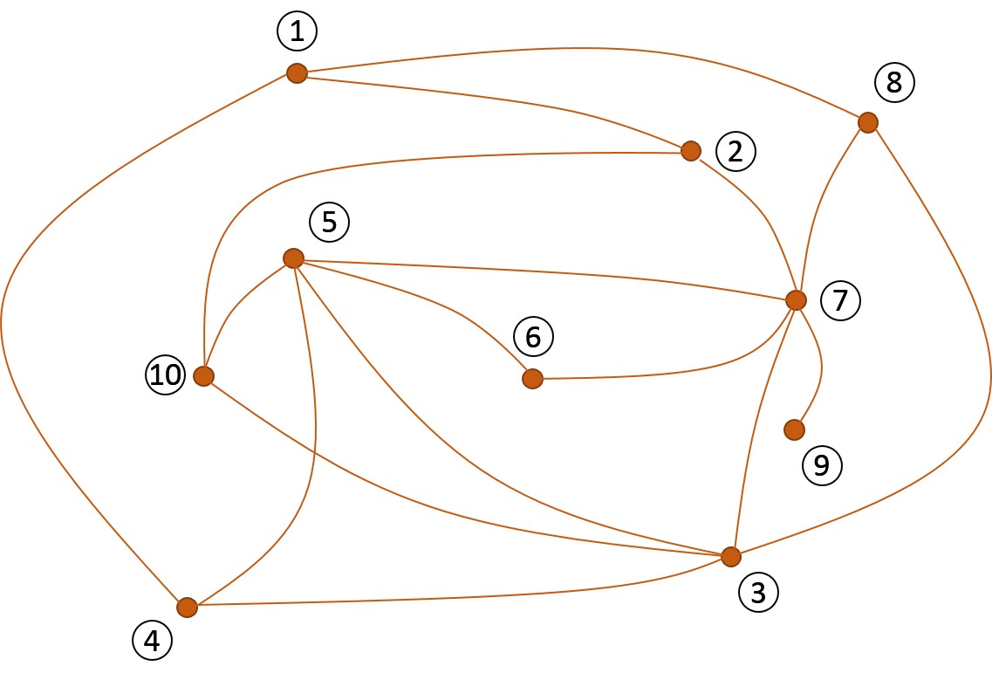
Sparse Matrix Structure
A “dot” for every non-zero entry
analogous

Slide 22
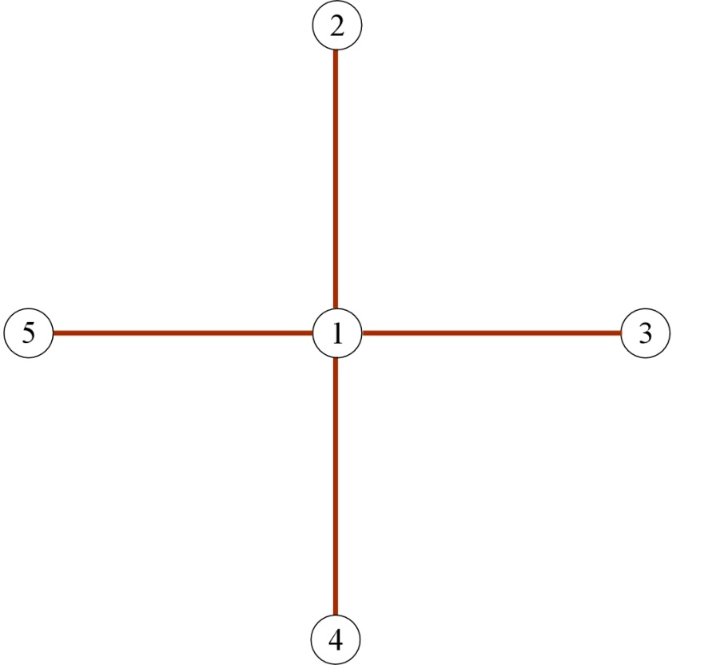
Ordering Schemes
The order in which the matrix nodes are numbered can have a significant impact on the amount of computation required solve Ax=b by LU factorization.
Matrix structure
Find Q and the number of multiplications and divisions required
graph

Slide 23
LU Factorization
 | Multiplications | Divisions
First column
First row
Second column
Second row
Third column
Third row
Fourth column
Fourth row
Fifth column
0
0
0
4
4
0
3
3
6
0
4
2
6
0
3
1
4
0
Total = α = 40
Fills = 12

Slide 24
Forward and Backward Substitution
 | Multiplications | Divisions
First row
Second row
Third row
Fourth row
Fifth row
0
1
1
1
2
1
3
1
4
1
 | Multiplications | Divisions
First row
Second row
Third row
Fourth row
Fifth row
4
0
3
0
2
0
1
0
0
0
Total = β = 25
α + β = 65

Slide 25
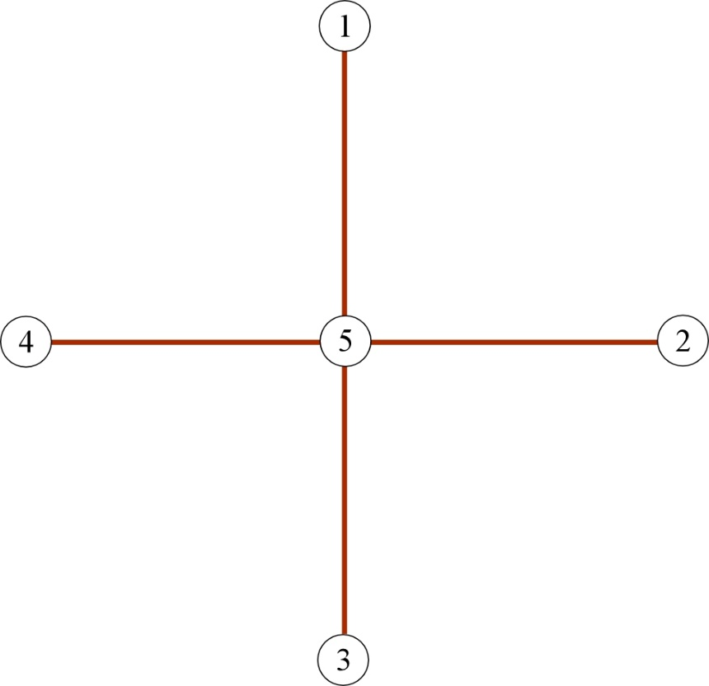
Matrix Reordered:
Matrix structure
Find Q and the number of multiplications and divisions required
graph

Slide 26
LU Factorization
 | Multiplications | Divisions
First column
First row
Second column
Second row
Third column
Third row
Fourth column
Fourth row
Fifth column
0
0
0
1
0
0
0
1
0
0
0
1
0
0
0
1
4
0
Total = α = 8
Fills = 0

Slide 27
Forward and Backward Substitution
 | Multiplications | Divisions
First row
Second row
Third row
Fourth row
Fifth row
0
1
0
1
0
1
0
1
4
1
 | Multiplications | Divisions
First row
Second row
Third row
Fourth row
Fifth row
1
0
1
0
1
0
1
0
0
0
Total = β = 13
α + β = 21

Slide 28
What made the difference?
The number of Fills!
A fill occurs when a matrix element that was originally zero becomes nonzero
during the factorization process.
5
Node 1 is factorized first (removed from graph)
Edges are added joining nodes to which node 1 was connected
4
1
2
(3-2)
(4-2)
(5-2)
(4-3)
3
(5-3)
(5-4)
12 Fills

Slide 29
Node
Fills
9
7
1
6
8
3
4
5
2
Find fills, α, and β
10
1
8
2
5
7
6
10
9
3
4

Slide 30
3
4
5
4
4
3
3
Number of non-zeros
4
2
1
5
6
5
5
4
4
3
2

Slide 31
This has fewer fills than this
We want a node ordering that produces the fewest fills.
It will have a “lower facing arrow” structure

Slide 32
Scheme 0
Calculate the degree of all vertices.
Choose the node with the lowest degree. Place in ordering scheme.
In case of a tie, choose node with lowest natural ordering.
Return to step 2.

Slide 33
Reorder using Scheme 0, find fills, α, and β
1
2
3
4
5
6
7
8
9
10
Node | degrees
1 | 3
2 | 3
3 | 5
4 | 3
5 | 5
6 | 2
7 | 6
8 | 3
9 | 1
10 | 3
New Order
9 | 6 | 1 | 2 | 4 | 8 | 10 | 3 | 5 | 7

Slide 34
New Order
Find Fills
9
6
1
2
4
8
10
3
5
7

Slide 35
Scheme 1
Calculate the degree of all vertices.
Choose the node with the lowest degree. Place in ordering scheme. Eliminate it and update degrees accordingly.
In case of a tie, choose node with lowest natural ordering.
Return to step 1.

Slide 36
Reorder using Scheme 1, find fills, α, and β
1
Node | degrees
1 | 3
2 | 3
3 | 5
4 | 3
5 | 5
6 | 2
7 | 6
8 | 3
9 | 1
10 | 3
8
5
4
4
2
4
3
5
4
4
7
2
6
10
1
4
2
5
3
4
1
3
2
9
3
4
New Order
9
6
1
10
4
2
3
5
7
8

Slide 37
Find Fills
9
6
1
10
4
2
3
5
7
8

Slide 38
Scheme 0 (minimum-degree) has the advantage of being easily implemented with improved results over non-ordering
Scheme 1 still relies on the minimum-degree approach, but it includes a simulation of the LU factorization process to update the node degrees at each step of the factorization (minimize α)
Scheme 2 endeavors to minimize the number of fills at each step of the factorization (minimize α and β).

Slide 39
Scheme 2
For each node, calculate the number of fills that would result from its elimination.
Choose the node with the lowest number of fills.
In case of a tie, choose node with lowest degree.
In case of a tie, choose node with lowest natural ordering.
Place node in ordering scheme. Eliminate it and update fills and degrees accordingly.
Return to step 1.

Slide 40
Reorder using Scheme 1, find fills, α, and β
Node | degrees | fills created
1 | 3
2 | 3
3 | 5
4 | 3
5 | 5
6 | 2
7 | 6
8 | 3
9 | 1
10 | 3
4
2-4, 2-8, 4-8
1
2-3, 2-5, 2-8, 5-8
8
1-7, 1-10, 7-10
1-7, 1-10, 5-8
7-10, 8-10
4-7, 4-8, 4-10
5-8, 7-10, 8-10
2
5
1-3, 1-5
4
3-6, 4-6, 4-7
4-10, 6-10, 7-10
1-7, 1-10, 7-10
7
4-7, 4-10, 7-10
6
none
10
2-3, 2-5, 2-6,
2-8, 2-9, 3-6, 3-9, 5-8, 5-9, 6-8, 6-9, 8-9
2-3, 2-5,
2-8, 5-8
4
2-3, 2-5, 2-6,
2-8, 3-6, 5-8, 6-8
5
9
1-7
1-3, 1-7
3
none
4
New Order
2-3, 2-5
9
6
4

Slide 41
Reorder using Scheme 1, find fills, α, and β
Node | degrees | fills created
1 | 3
2 | 3
3 | 5
4 | 3
5 | 5
6 | 2
7 | 6
8 | 3
9 | 1
10 | 3
none
4
2-4, 2-8, 4-8
2-3, 2-5, 2-8, 5-8
2-3, 2-5
1
1-7, 1-10, 7-10
1-10, 7-10
8
1-7, 1-10, 5-8
7-10, 8-10
4-7, 4-8, 4-10
5-8, 7-10, 8-10
none
4
1-10, 7-10
3
2
1-3, 1-5
5
3-6, 4-6, 4-7
4-10, 6-10, 7-10
4
1-7, 1-10, 7-10
2
4-7, 4-10, 7-10
3
1-10, 7-10
none
7
none
10
2-3, 2-5, 2-6,
2-8, 2-9, 3-6, 3-9, 5-8, 5-9, 6-8, 6-9, 8-9
3
2-3, 2-5,
2-8, 5-8
2
4
none
1
5
2-3, 2-5
1-7
1-3, 1-7
none
3
none
4
2-3, 2-5
1
3
2
New Order
9
6
4
8
2
1
3
5
7
10

Slide 42
Node | degrees | fills created
1
2 |  | 1-10, 7-10
3
4 |  | 1-3, 3-5
5
6
7
8 |  | 1-7
9
10
9
6
4
8
2
1
3
5
7
10

Slide 43
Scheme | α | β | α + β
No ordering | 134 | 68 | 202
Scheme 0 | 110 | 60 | 170
Scheme 1 | 92 | 56 | 148
Scheme 2 | 84 | 54 | 138

Slide 44
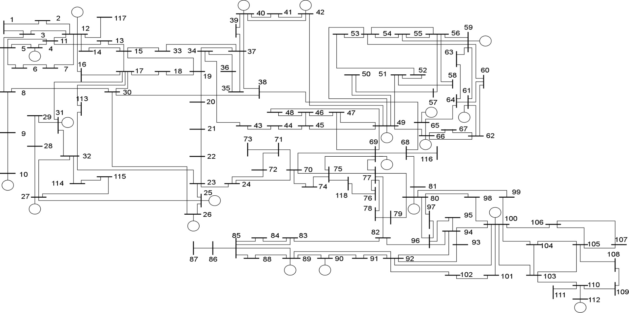
Power System Applications

Slide 45
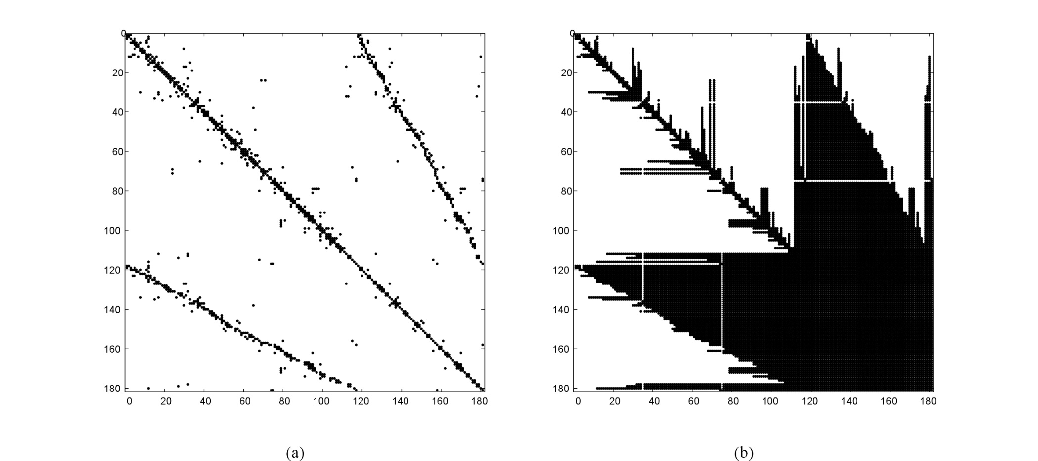
No Ordering

Slide 46
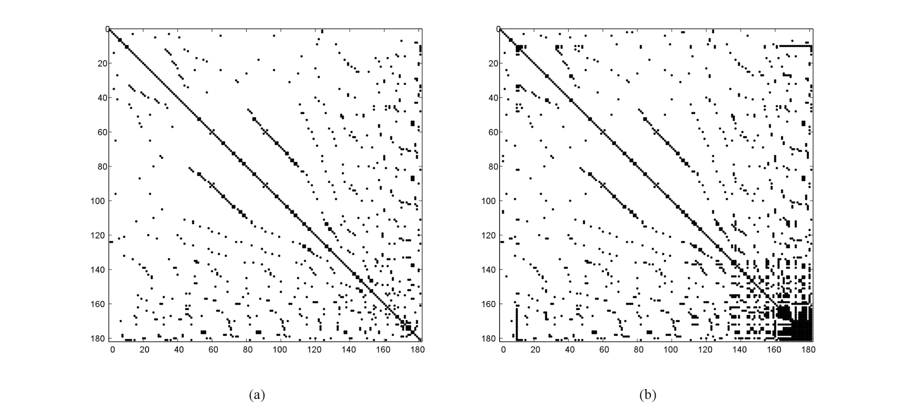
Scheme 0

Slide 47
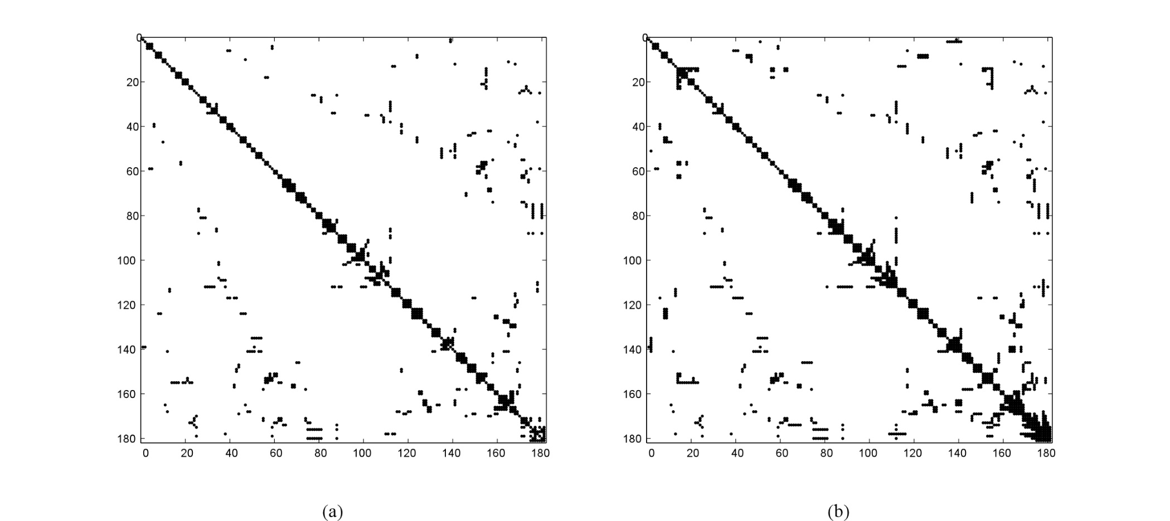
Scheme 1

Slide 48
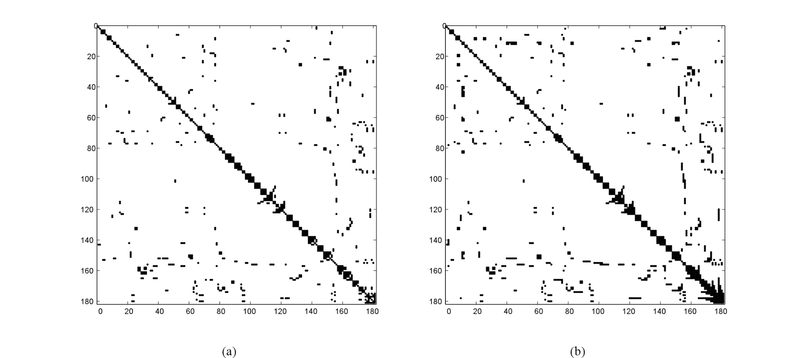
Scheme 2

Slide 50
Announcements
Chapter 4
Read Papers for Discussion Set
Work on Program #1

